Slide 1


Is Learning Design helpful for Formation? Can it be unhelpful?
Professor James Dalziel
Dean of Education, Morling College &
Professor, University of Divinity
jamesd@morling.edu.au
Keynote presentation for ANZATFE, Morling College
December 6th, 2017

Slide 2
Overview
What is Learning Design?
“Teaching strategy” examples
  Problem-Based Learning & Role plays
  Developing Scenario Learning (DSL)
When is Learning Design helpful for formation?
Can Learning Design be unhelpful for formation?

Slide 3
Learning Design
For many lecturers, the focus of “design” in their teaching is on curriculum/content design
  How to I select and order the most important concepts?
In some fields, including theological formation, there is a greater focus on the activities that foster learning, not just on delivery of content
  Other fields include creative writing, counselling practice, redesign of medical education, language learning, other adult learning/vocational courses, higher education T&L, etc

Slide 4
Learning Design
For some educators, Learning Design means “effective teaching” or “designing for effective teaching”
Over the past 15 years Learning Design has developed as an education sub-discipline that is a mixture of educational theory and educational technology
Learning Design seeks to describe and share effective teaching strategies built on activities, not just content
  Often involving technology, although not necessarily

Slide 5
Learning Design
The “Larnaca Declaration on Learning Design” is a recent summary of the field – it identified three core ideas:
  A language/framework for sharing effective teaching ideas
  A conceptual map of how Learning Design fits within education
  Ideas about effective practice using Learning Design
  See https://www-jime.open.ac.uk/articles/10.5334/jime.407/
Part of my work in Learning Design is implementing these ideas in an open source Learning Design system (LAMS)
  Disclosure: While LAMS is free, I have a financial interest in the (optional) LAMS support company (LAMS International Pty Ltd)

Slide 6
Learning Design
Learning Design Conceptual Map
(LD-CM)
Learning Design Framework
(LD-F)
Learning Design Practice
(LD-P)
The Larnaca Declaration on Learning Design

Slide 7
Learning Design & Teaching Strategies
A Learning Design is any “good teaching idea” or “teaching strategy” that has a particular activity structure, typically based on some theory of learning
  Often described as a sequence of learning activities, although not necessarily a linear sequence (eg, spiral)
Example from science education:
Predict – Observe – Explain
Practical Activity: Try describing a teaching strategy from your own experience to your neighbour
  Neighbour: Do you now know enough to replicate it yourself?

Slide 8
Learning Design Framework
What is the essential information to convey to other educators if they want to replicate your teaching strategy?
What framework could you use to structure this information to foster ease of communication?
This “meta-level” is the Learning Design Framework behind the descriptions
  Various early Framework examples discussed in the JIME article

Slide 9
Predict Observe Explain from
AUTC Project

Slide 10
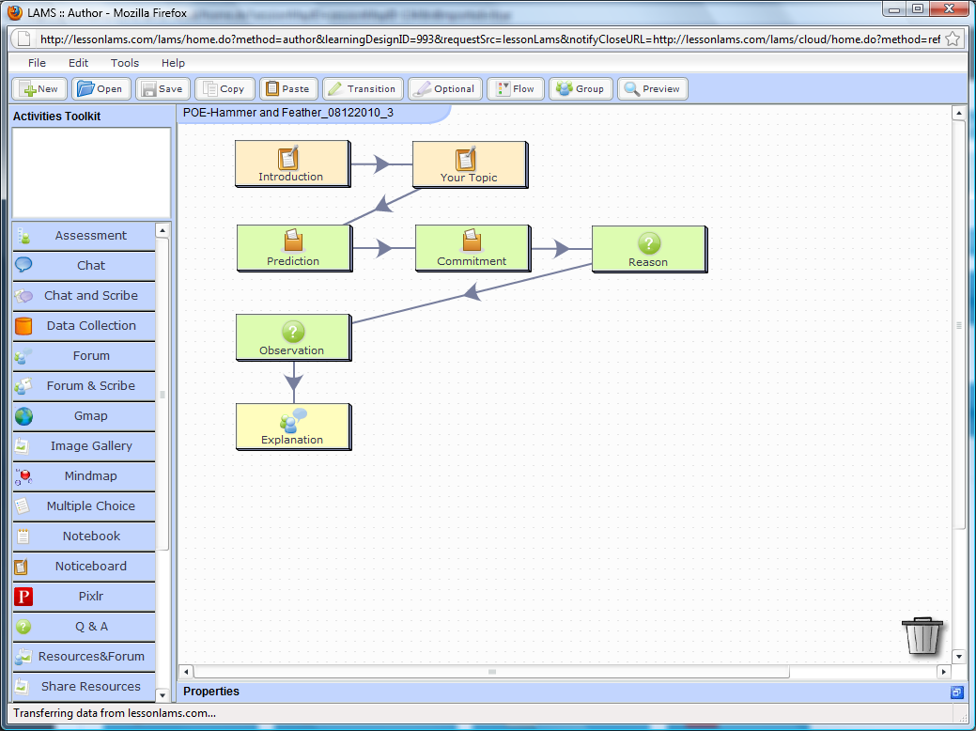
Example of Teaching Strategy “Predict Observe Explain” in LAMS Author

Slide 11
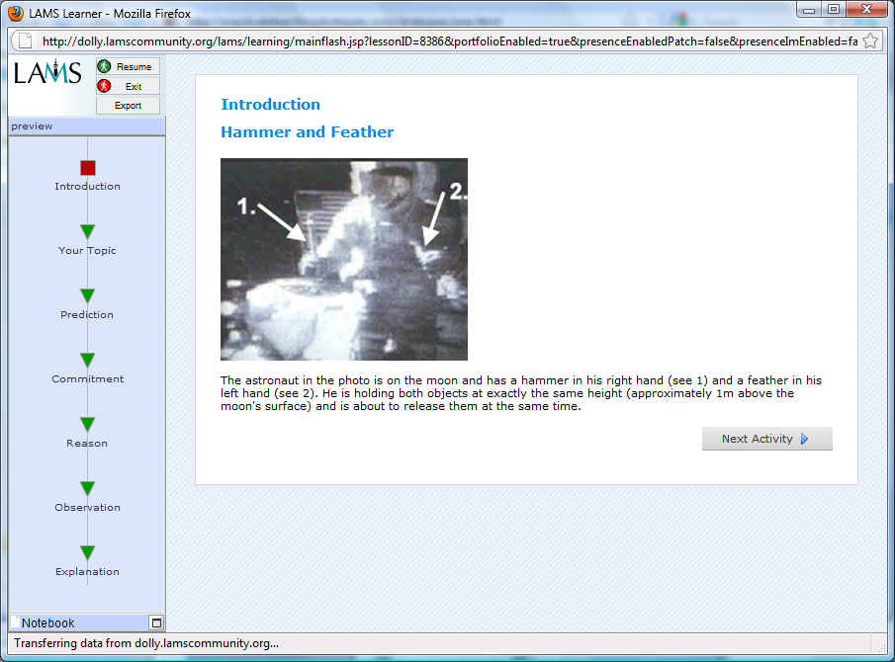
Predict – Observe – Explain: Preview (student view) of Content Example

Slide 12
Sharing Learning Designs
LAMS Community (www.lamscommunity.org)
  Community sharing, adaptation and improvement of Learning Designs
  Sequences shared under Creative Commons licenses
  (free to use, free to modify)
LAMS Community fosters the idea of educators creating and sharing teaching strategies together

Slide 13
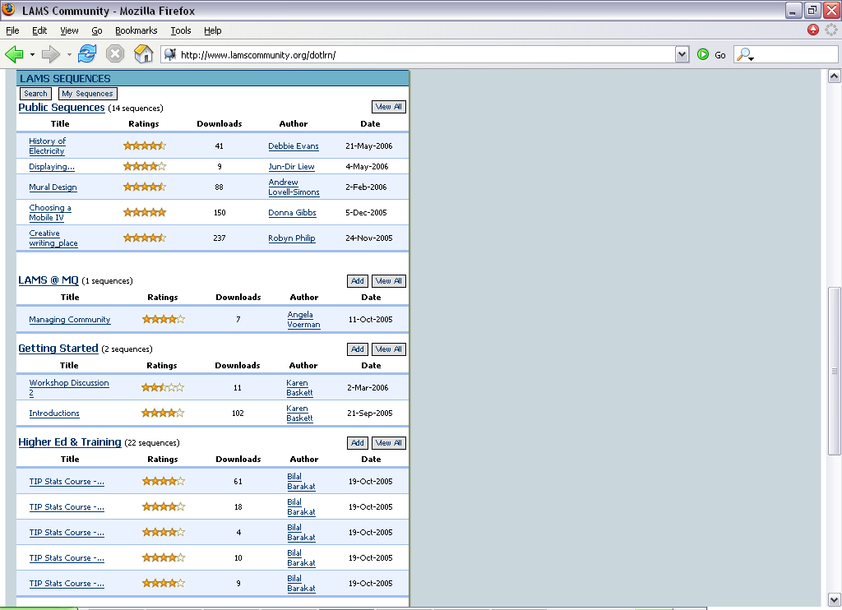
LAMS Community – Repository Summary

Slide 14
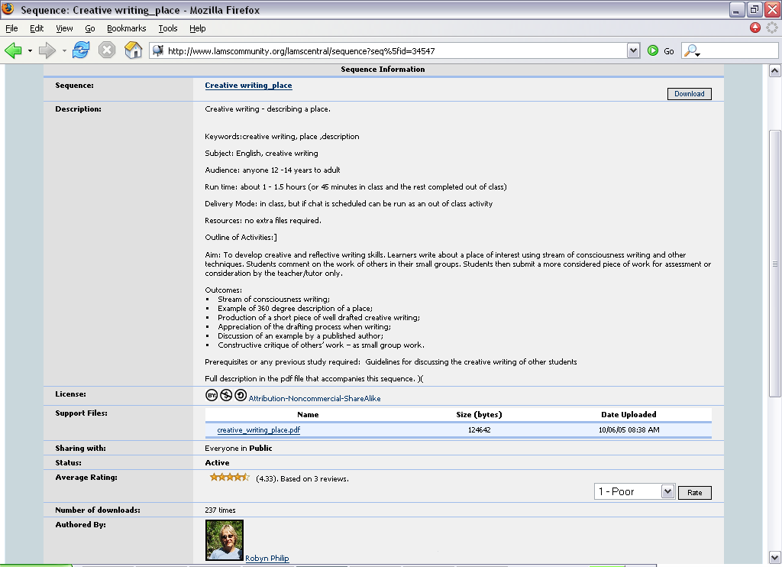
LAMS Community – Detailed view of individual sequence

Slide 15
Challenge
Creating learning experiences aligned to particular pedagogical approaches and learning objectives
Educational Philosophy
Teaching Cycle
All pedagogical approaches
All disciplines
Engage with students
Reflection
Professional Development
Design and Plan
Level of Granularity
Program
Module
Session
Learning Activities
Theories & Methodologies
A range based on assumptions about the Learning Environment
Learning Environment:
Characteristics & Values
External Agencies Institution
Educator Learner
Core Concepts of Learning Design
Guidance Representation Sharing
Implementation
Tools Resources
Learner Responses
Feedback Assessment Learner Analytics Evaluation

Slide 16
Practical Examples
How can Learning Design and LAMS help foster innovative approaches to teaching and learning?
  Problem-Based Learning
  Role Plays
  Developing Scenario Learning
For examples and details on PBL and role play, see
http://practicaleteachingstrategies.com/index.html
http://practicaleteachingstrategies.com/files/LAMSbook2010.Final.pdf
For Developing Scenario Learning, see handout

Slide 17
Problem-Based Learning
A teaching strategy that has been widely adopted in medical education, and increasingly in other areas
Based on small groups with a facilitator
  Start with an authentic problem
  Student discuss problem, go away to conduct research
  Return to share ideas, often identify further research needed
  Share ideas, formulate a solution and rationale
  Facilitator to guide and provide feedback, but not “teach”
Would anyone like to share a PBL example?

Slide 18
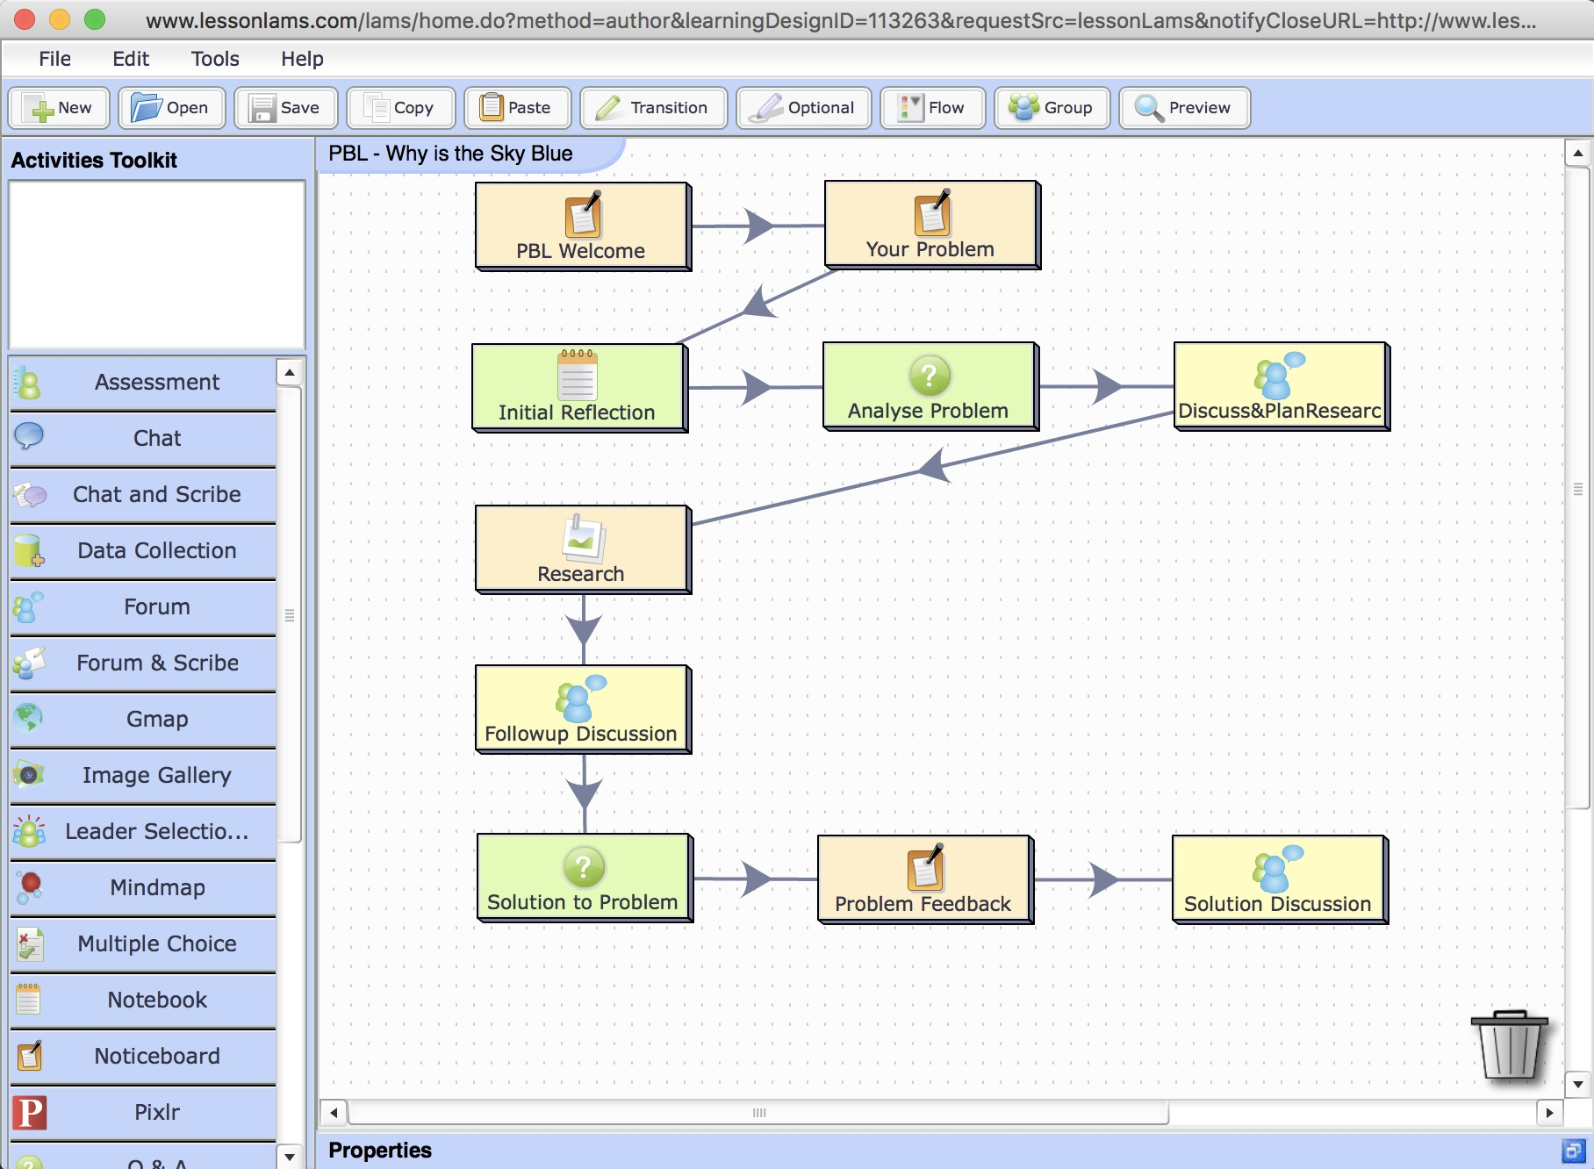

Slide 19
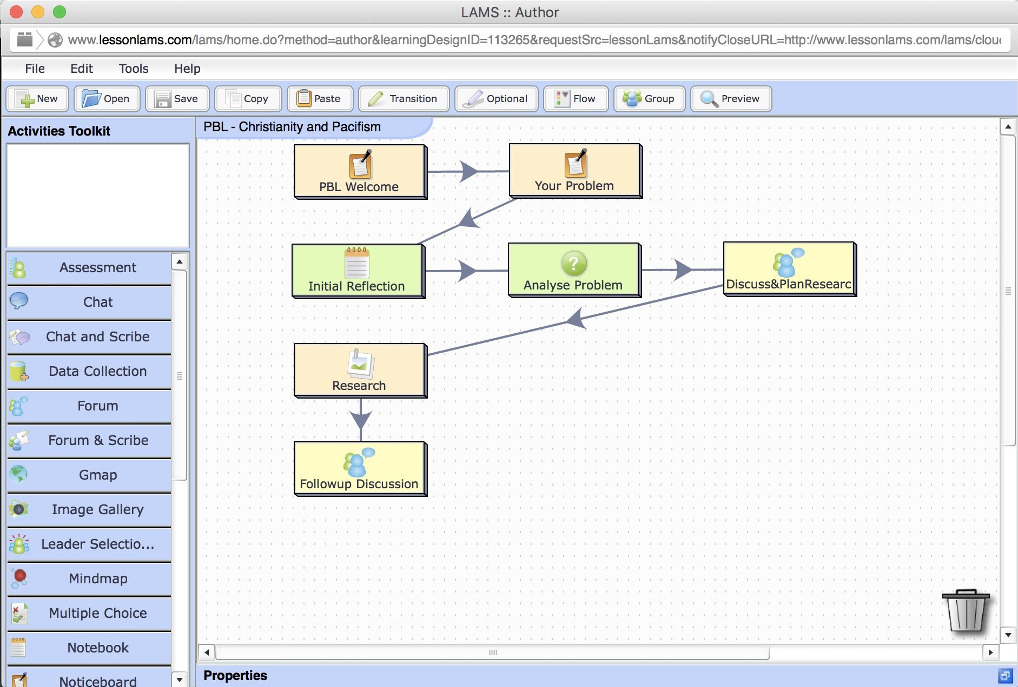
PBL about Christianity and Pacifism: Last 4 activities combined

Slide 20
Problem-Based Learning
Reasons for going beyond “traditional” PBL:
Disciplines where a “right answer” is absent, or less important than reflection on various possible answers
Students sometimes have a “task orientation” to PBL, rather than a more reflective personal orientation
  “get the problem solved” vs “what does this mean for me?”
PBL problems are usually “static”, so may not foster enough flexible thinking / ability to adapt

Slide 21
Role Play
A teaching strategy where students are given a scenario in which they take on a role
Often involves multiple students in each role
  Allows for small group research/discussion “inside” a role group prior to main role play
Focus on trying to see the world from a different perspective – “walking in the shoes of another”
  Debrief after role play – reflect on personal implications
Time intensive, but can foster deep learning experiences
Would anyone like to share a role play example?

Slide 22
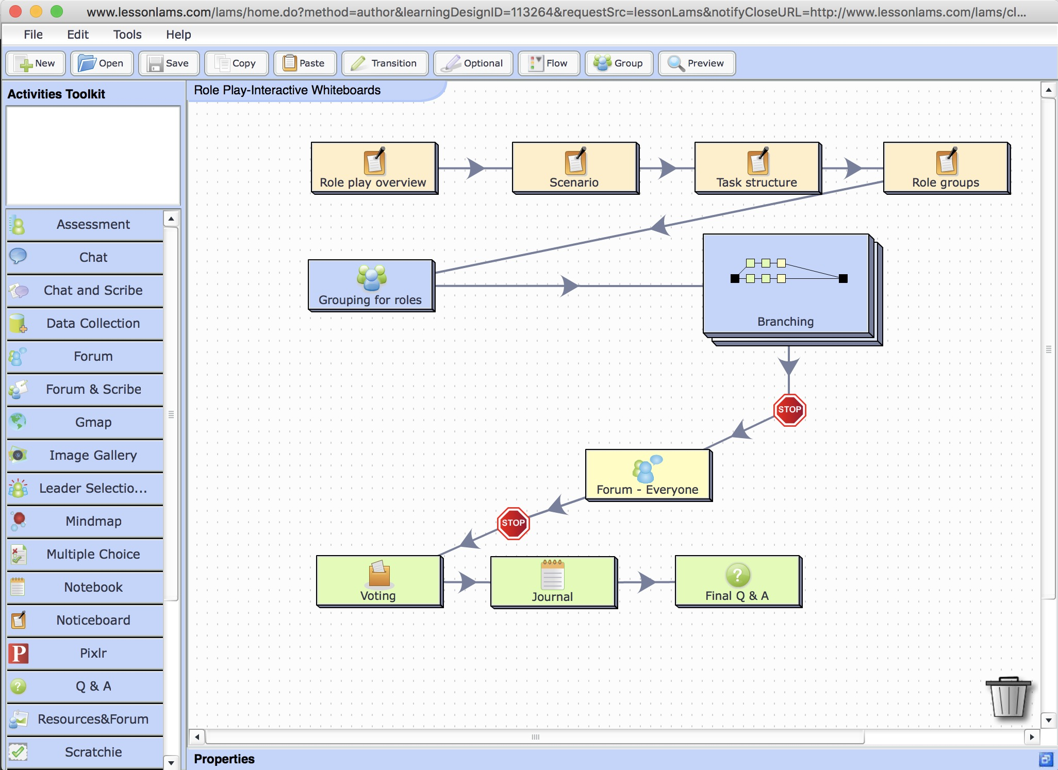

Slide 23
Role play
Reasons for going beyond “traditional” role play:
Taking on a role means stepping outside yourself, but for some types of learning, it is your own (deep) assumptions that should be the focus of reflection
Avoid a “split” between “role play attitudes” and “debriefing attitudes”
  Focus on your own attitudes throughout a scenario
Some role plays have evolving scenarios, but not many
  Chance to draw attention to this attractive idea

Slide 24
Developing Scenario Learning (DSL)
A hybrid of PBL and role play
  Uses authentic problem idea and research from PBL
  Uses scenario idea from role play, but response to scenario is as yourself (not a role)
Key element is reflecting on a scenario with peers to understand situation and share ideas on how to interpret
  Create a rationale for possible future action
Then – scenario evolves
  May require changes to action; reconsider original assumptions
Appropriate for theological education areas such as ethics, ministry/practice, apologetics, etc

Slide 25
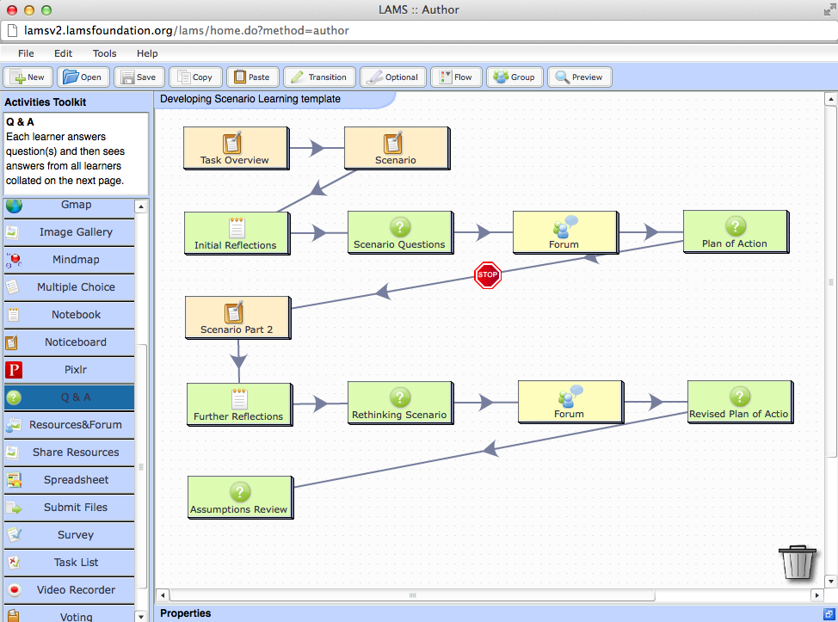
Template for Developing Scenario Learning

Slide 26
Developing Scenario Learning (DSL)
Example: You are a relatively new minister in a church in a large rural town, which has been fairly “fixed in its ways” in the past. A new couple came to the church from a big city a year ago, and have reinvigorated the church music by developing a band with contemporary music, and a drama group. Church attendance has risen due to these changes, especially among young people, but a number of the long-standing members are unhappy with the changes – particularly the style and volume of the music. There are comments that the big city “blow ins” are making too many changes too fast, and that they don’t even belong to this denomination.

Slide 27
Developing Scenario Learning (DSL)
What are your initial thoughts?
  Share thoughts with group
What knowledge issues might be at play?
What attitude issues might be at play?
What emotional issues might be at play?
What additional information/research might you need (either for yourself, or to address the situation)
What do you see as the problem, and what is your plan of action to address this problem?

Slide 28
Developing Scenario Learning (DSL)
One month later: The unhappy long-standing members have found a church ordinance that says that only people who are signed up members of the denomination can “lead” any church activity. They use this to seek to remove the new couple from their leadership of the music and drama groups. Several supporters of the couple encourage them to sign up to the denomination officially, but the couple are not willing to do this, as they say it shouldn’t matter. Unable to resolve this issue, the couple leave the church very unhappy. The band and drama group dissolve, and young people numbers drop off.

Slide 29
Developing Scenario Learning (DSL)
What are your new thoughts?
  Share thoughts with group
How did your initial assessment of the situation fit with the outcome of the couple leaving?
How do you need to revise your strategies in the light of the couple leaving?
What additional information/research do you need?
What is your revised plan of action?
What are your reflections on the whole scenario?

Slide 30
Developing Scenario Learning (DSL)
A central idea for DSL is that unexpected events can happen, and the importance of reflecting on a range of possibilities when approaching a problem at the start
Focus on students being flexible / ability to adapt to changing circumstances
  Often missing from other teaching strategies (eg, PBL)
NB: Would need to avoid over-using this kind of DSL, as students would tend to jump to “unlikely” outcomes during first stage once they knew of this possibility
  Retain some “as expected” evolving scenarios in a set

Slide 31
Developing Scenario Learning (DSL)
DSL is not a completely new teaching strategy
  It is likely that teachers have created activities with the same sort of structure as suggested, just didn’t have a special name!
A key challenge for future adoption of DSL is whether lecturers find the structure helpful to organise their ideas
  As opposed to just “make up” a lesson plan from scratch
Multiple DSLs can be used for a whole unit
  Eg, 6 x 2 week DSL
To view and download the Theology example, see
http://lamscommunity.org/lamscentral/sequence?seq_id=1856807
  For general how to use LAMS, see: http://wiki.lamsfoundation.org/display/lamsdocs/Home

Slide 32
When is Learning Design helpful for spiritual formation?
Learning Design places a focus on activities for learning, not simply content
  Particularly relevant to spiritual formation
Learning Design encourages exploring and sharing new “teaching strategies”
A focus on teaching strategies encourages educators to think about the reasons for choosing certain activities
  What is your “mini theory” behind a given learning experience?

Slide 33
Learning Design
Learning Design Conceptual Map
(LD-CM)
Learning Design Framework
(LD-F)
Learning Design Practice
(LD-P)

Slide 34
Challenge
Creating learning experiences aligned to particular pedagogical approaches and learning objectives
Educational Philosophy
Teaching Cycle
All pedagogical approaches
All disciplines
Engage with students
Reflection
Professional Development
Design and Plan
Level of Granularity
Program
Module
Session
Learning Activities
Theories & Methodologies
A range based on assumptions about the Learning Environment
Learning Environment:
Characteristics & Values
External Agencies Institution
Educator Learner
Core Concepts of Learning Design
Guidance Representation Sharing
Implementation
Tools Resources
Learner Responses
Feedback Assessment Learner Analytics Evaluation

Slide 35
Can Learning Design be unhelpful for formation?
Where is improvisational teaching in Learning Design?
  What about the things you do “on the spur of the moment?”
Where is actively responding to the spirit of a class, or an individual, and adapting your teaching plan accordingly?
Is there a risk that too much design/planning could stifle flexibility and improvisation?

Slide 36
How can Learning Design be unhelpful?
Yes, Learning Design is weak in these “improvisational” areas, although it acknowledges the issue (see JIME)
  If Learning Design is analogous to music notation for sharing different kinds of music
  Then some Learning Designs are like Jazz – which involves lots of improvisation, but usually around some underlying structure
So the use of Learning Design in spiritual formation can be helpful (for sharing good teaching strategies) or unhelpful (if it leads to undue rigidity)
  Both depend on implementation

Slide 37
Discussion
How could Learning Design be helpful in your context?
How could it be unhelpful?

Slide 39
Workshop
Open structure – Potential topics:
Discussion of Learning Design theory
Discussion of LAMS
Discussion of PBL, Role Play, DSL
Practical task on PBL, Role Play, DSL
Discussion of benefits and problems of Learning Design
Other?

